Slide 1

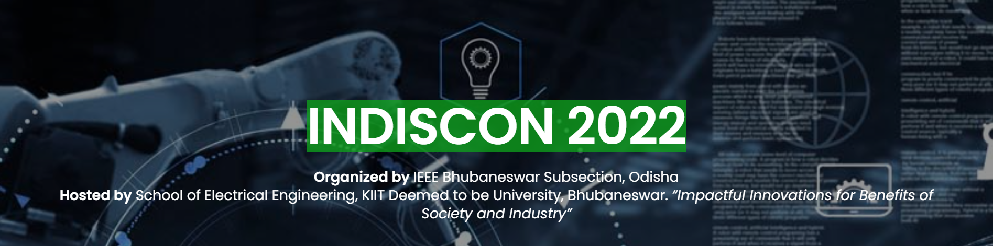
PAPER ID 152
IoT Book Bot
¹Souvik Datta, ² Mangolik Kundu,
³ Ratnadeep Das Choudhury, ⁴ Sriramalakshmi P,
⁵ Sreedevi VT
^{1,2,3,4,5} Vellore Institute of Technology, Chennai, India
Notes:
Greetings to one and all present here.
My name is Souvik Datta, I am a btech 3rd year student at vit chennai, and I am here with my co-authors mangolik kundu and ratnadeep das choudhury today to talk to you about the IoT Book Bot, which has been co-authored by Sreedevi vt and sri p.
Even though a major part of modern-day library management system has been automated still there remains a significant gap in the field of timely and secured submission of books back to the library.
As per a survey conducted, it was found that most of the overdue books were as a result of either students being forgetful or the students not finishing with their books. It was also found that renewal was the most favored overdue measure among the students
This research article which is essentially a robot carrying books will help reduce the workload of the library management system. Moreover, it will also save time and make it a much more hassle-free process for students

Slide 2
Introduction
Tools and Technologies
Block Diagram & Circuit Diagram
Expected Results
Conclusion
Future Scope
References
Contents

Slide 3
Introduction
Robot will ensure the timely submission of issued books from the library.
It is enabled with a barcode scanner using OpenCV.
Can remotely drive the robot back to the library.
Notes:
Our robot will ensure the timely submission of issued books from the library and reduce the workload of the library. Moreover, it will also save the time and energy of students in the process.
It will be enabled with a barcode scanner to ensure the correct submission of books and will also have a QR code scanner which will scan an unique QR code provided to every student to verify the student. After submission it will store the submission information in database.
After the inventory of the robot gets filled up, the staff members can remotely drive the robot to the library to submit the books. To make the driving easier, the robot will be enabled with Ultrasonic sensors and real-time video tracking systems.

Slide 4
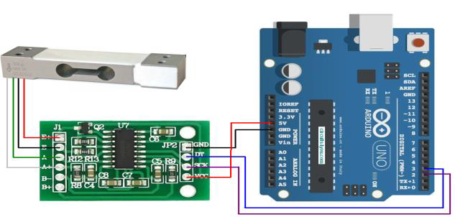
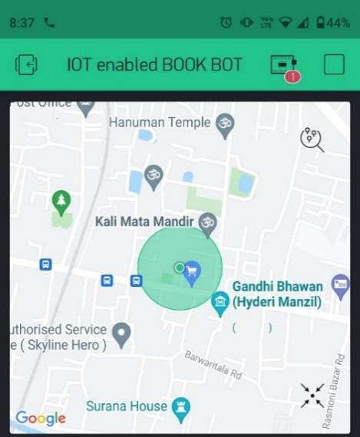
Tools and Technology
QR Code & Barcode Decryption
Blynk Communication Interface
HX-711 Load Cell Amplifier Module
Neo-6M GPS Module
Fig. 1. HX-711 Load Cell
Fig. 2. GPS Live Location
Notes:
The Bot encapsulates the use of Raspberry Pi and Pi Camera for all computer vision operations. The bot is designed to transverse via a remote control while returning a live video stream and Global Positioning System (GPS) location. Furthermore, it also provides a secure interface for book exchange.
Our proposed model uses the Python’s pyzbar module to decode one dimensional QR-Code of students and barcodes from Books to update the database during submissions. Using the ‘decode’ function of the library, which returns an array of objects, with each element of the array representing the detected QR/Barcode
In this paper, Blynk is integrated with an NodeMCU ESP-8266 for motor control the data is also visualized from the HC-SR04 Ultrasonic Distance Sensor and Neo-6m GPS Module for real time tracking.
HX-711 is a precision 24-bit analog to-digital converter (ADC) designed for weigh scales. HX-711 Load Cell Module converts the pressure (force) applied into an electrical signal. It is an electronic transducer which converts force into weak micro-voltage level electric signal.
The Neo-6M GPS Module covers over fifty channels, has a sensitivity of -161 decibels(dB) while consuming only 45mA of supply current.

Slide 5
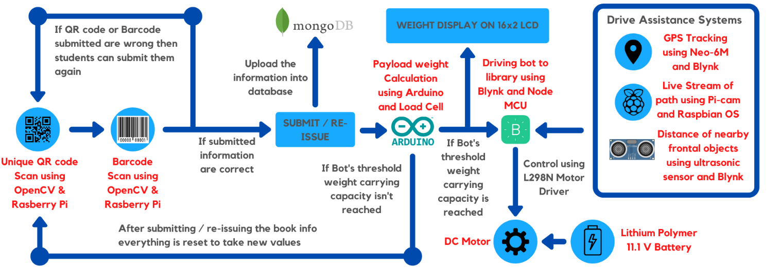
Block Diagram
Fig. 3. Block Diagram of the entire workflow
Notes:
In our model's Block Diagram, the unique qr and barcode are scanned, then the details are compared with the database, and we are given the option of submitting or re-issuing. The arduino calculates the new payload weight and uploads the information to the database. When the weight surpasses the threshold, the library can drive the bot back. It is possible to visualise it using GPS tracking and video stream.

Slide 6
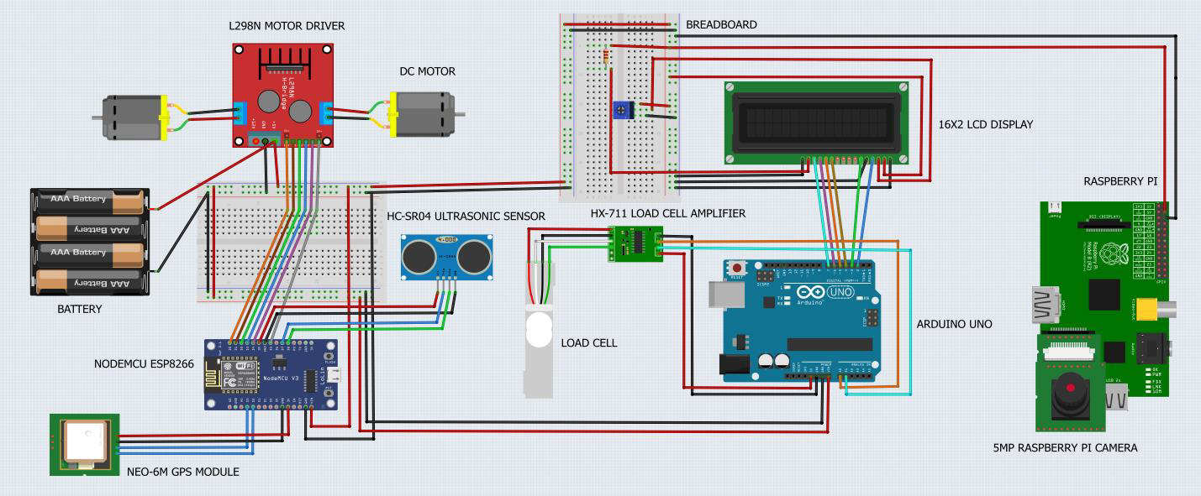
Circuit Diagram
Fig. 4. Circuit Diagram of the Model
Notes:
A 11.1V power supply is connected to the L298N Motor driver in the circuit, which lowers down the voltage to 5v and supplies three microcontrollers (the arduino, the nodemcu esp8266 and the Raspberry Pi)
The nodemcu is in charge of all IOT-based controls. It receives data from the ultrasonic sensor and the Neo 6m GPS module and controls the 12 V DC motors via the L298n motor driver.
The Blynk app is linked to the nodemcu. As a result, the data from the ultrasonic sensor, which indicates how far an obstacle is from the book bot, is collected by the nodemcu and displayed on the blynk app interface. It also displays the coordinates obtained from the Neo 6m Gps on the Blynk app interface.
The payload computation is essentially the responsibility of the arduino. A HX711 load cell amplifier connects it to a load cell. The arduino weighs the payload to ensure it does not exceed the bot chassis's safe weight bearing capacity. The payload weight is also shown on the 162-inch LCD display.
Last but not least, the Raspberry Pi is linked to a 5MP Raspberry Pi camera, which transmits a livestream of what is happening in front of the camera to the bot's controller at all times, working as a safety feature.

Slide 7
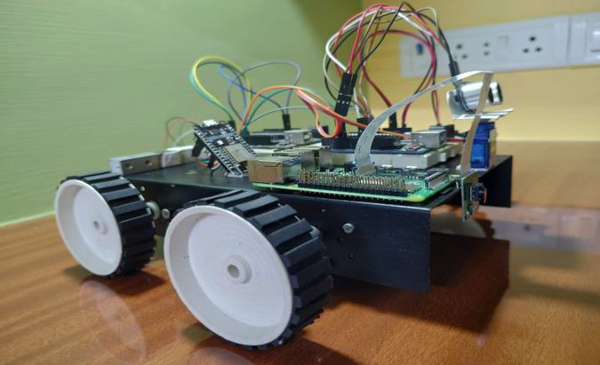
Hardware Model
Fig. 5. Proposed Hardware Model

Slide 8
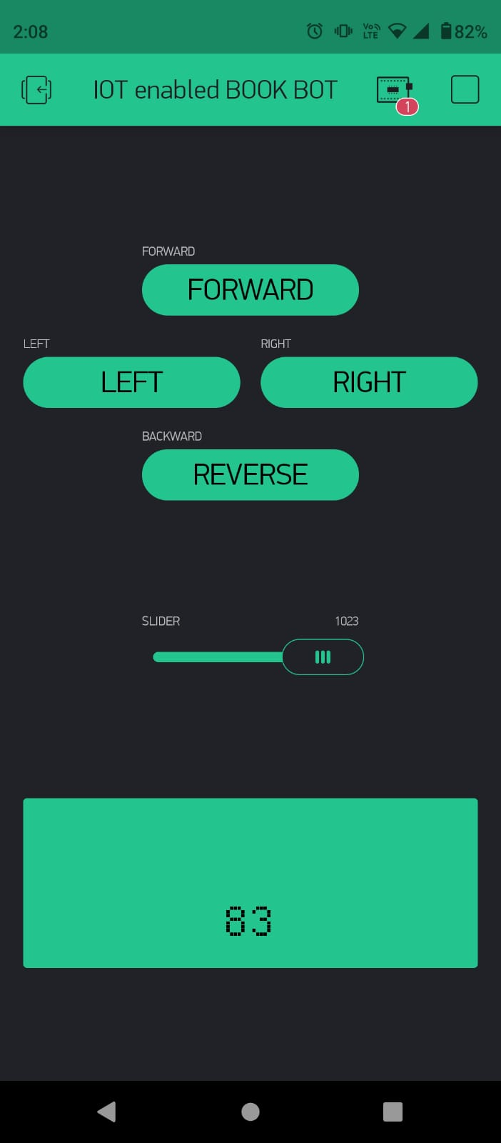
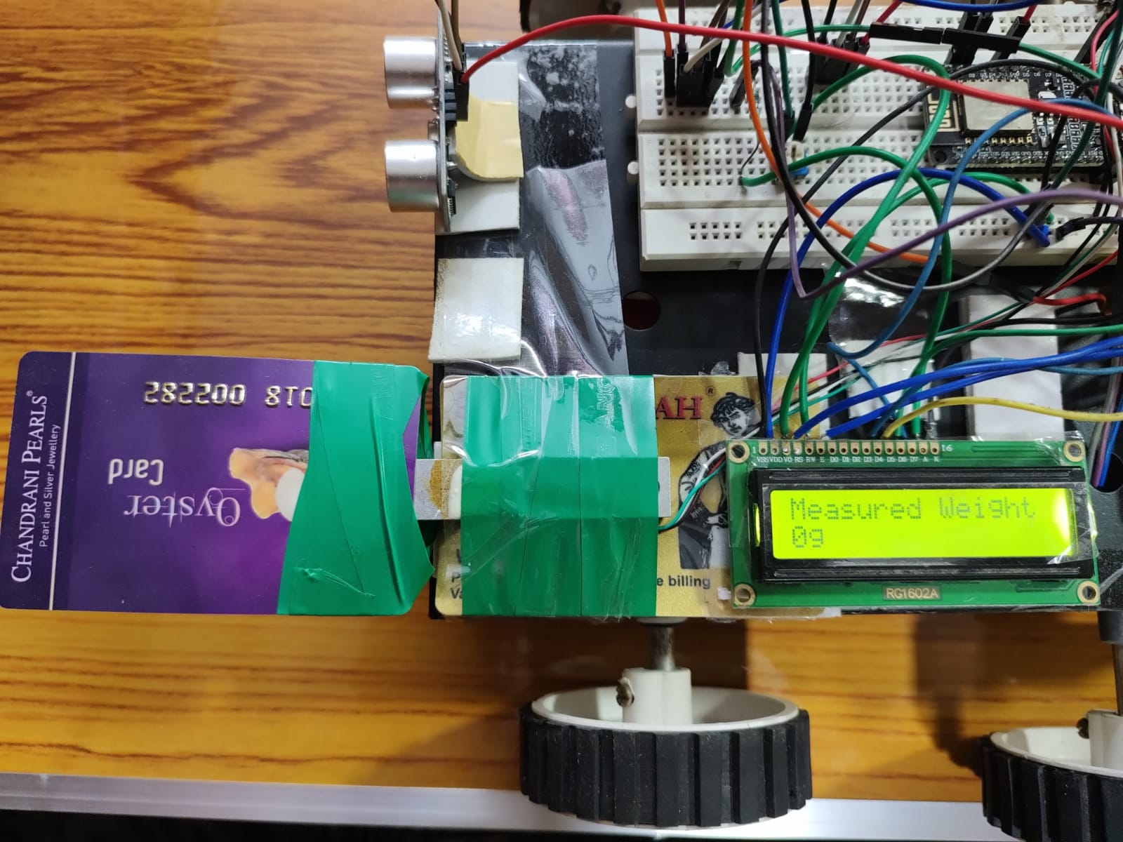
Fig. 6. Odometry controls on Blynk App
Fig. 7. Weight cantilever alongside LCD

Slide 9
Conclusion
Robot can be present in the student’s hostels for submission or re-issuing of books
Bot is provided with a GPS Module, Distance Sensors and a live video stream through Pi Camera to assist the controller.
Help the library management system by automating a major part of it.
Notes:
In this paper, we present a solution to the problem of students being forgetful in returning issued library books through a IoT based Book Robot.
The robot can be present in the student’s hostels for submission or re-issuing of books.
The bot is provided with a GPS Module, Distance Sensors and a live video stream through Pi Camera to assist the controller.
Through this work, we have tried to present a solution to the problems of students with overdue books, how a robot can help them with better time management and forgetfulness. This can not only save students from paying fines due to late submission but also help the library management system by automating a major part of it. The simple technology behind the robot not only reduces human intervention but also makes it more reliable.

Slide 10
Future Scope
Develop a autonomous Book Bot.
Smart Mobile Application for the users.
Upgrade the overall UX by adding a Thin Film Transistor (TFT) Touch Screen.
Notes:
As the world is abuzz with semi-autonomous and fully autonomous vehicles, the most desirable objective would be to create a fully autonomous Book Bot.
In view of the ongoing pandemic, peer engagement in libraries has been restricted to the minimum. Moreover, students find it difficult to access the library's resources [15]. Thus, a complete autonomous system can solve a major part of the entire logistics operation.
The paper can be further upgraded to allow request-based book delivery to students.
This will require us to integrate the present hardware with RGB-Depth Camera and Light Detection and Ranging Sensor (LiDAR).
Smart Mobile Application for the users to provide a more reliable, personalized and convenient experience. The mobile application which will include the following features –
a. Book Issue History
b. Complete Library Book List
c. Due Date Notification
d. Submission/Re-Issue Confirmation with Real Time Notification
e. Live Availability of a vacant Bot
These features will ensure a better User Interface and Experience (UI & UX)
Lastly, we aim to upgrade the overall UX by adding a Thin Film Transistor (TFT) Touch Screen. The TFT Display will completely remove the need for a Laptop Screen during submission adding to the robustness of the project.

Slide 11
References
[1] I Alao. A. “Students and overdue books in a medical library”. 2002 Journal of the Medical Library Association: JMLA, 90(3), 294–297.
[2] D. Shontz. “Effect of fines on length of checkout and overdues in a medical library”. Bulletin of the Medical Library Association, 87(1), 82.
[3] M. Bdiwi and J. Suchy, “Library automation using different structure of vision-force robot control and Automatic Decision System,” 2012 IEEE/RSJ International Conference on Intelligent Robots and Systems, 2012.
[4] R. Kadhane, A. Kumar, K. Bhattad, and A. Srivastava, “Surveillance through semi-autonomous bot,” 2021 International Conference on Design Innovations for 3Cs Compute Communicate Control (ICDI3C), 2021
[5] D. Singh, P. Zaware, and A. Nandgaonkar, “Wi-Fi Surveillance Bot with Real Time Audio & video streaming through Android Mobile,” 2017 2nd IEEE International Conference on Recent Trends in Electronics, Information & Communication Technology (RTEICT), 2017.
[6] V. G. Rajendran, S. Jayalalitha, S. Radhakrishnan and S. Arunbhaarat, Webpage controlled surveillance bot using Raspberry Pi," 2020 Fourth International Conference on I-SMAC (IoT in Social, Mobile, Analytics and Cloud) (I-SMAC), 2020, pp. 549-553, doi: 10.1109/I- SMAC49090.2020.9243320.
[7] M. Bayani, A. Segura, M. Alvarado, and M. Loaiza, “IOT-based Library Automation & Monitoring System: Developing an implementation framework,” e-Ciencias de la Información, vol. 8, no.1, 2017.
[8] A. Suhail et. al., "Automated Library System Using SMS Based Pick and Place Robot", International Journal of Computing and Digital Systems, vol. 8, no. 6, pp. 535-544, 2019
Notes:
These are some of the papers we had referred to.
Thank you.
We are open to any questions you have for us.

